Slide 1



Soundec 深圳市九音科技
SNC8x series professional audio processor
32 bit processor/ HiFi3 Architecture / Codec / UAC
●Company Profile ●Architecture ●Application ●Package

Slide 2




公司简介
Company Profile
Focus on acoustic research and commercialization
Shenzhen Soundec Technology Co., Ltd. (“Soundec Technology ”) is a high-tech enterprise focusing on acoustic research and commercialization. Founded in 2017, we seek to consistently deliver excellent solutions in the areas of audio.
Building upon our core competence in audio processing technology,, Soundec Technology provides a series of professional audio processors integrating AI algorithms, high-quality codecs, high-performance DSP, high-speed USB and power management units. Support in-depth development and turn-key solutions for algorithm + chip + application design.
Cooperation with the top semiconductor IP partners and chip manufacturers, Soundec Technology is committed to creating a serials of world-class audio processors and solutions, providing customers with reliable quality, stable supply and professional service acoustic solutions.

Slide 3
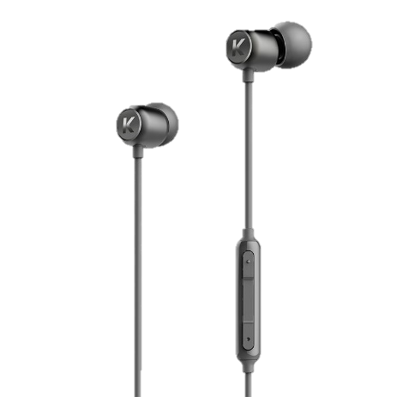
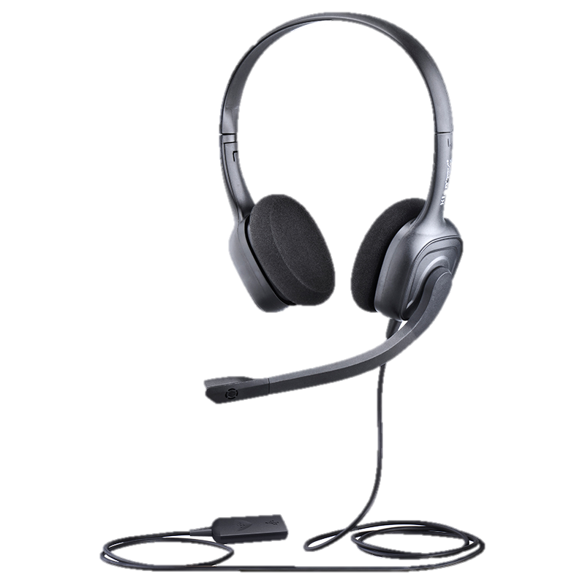
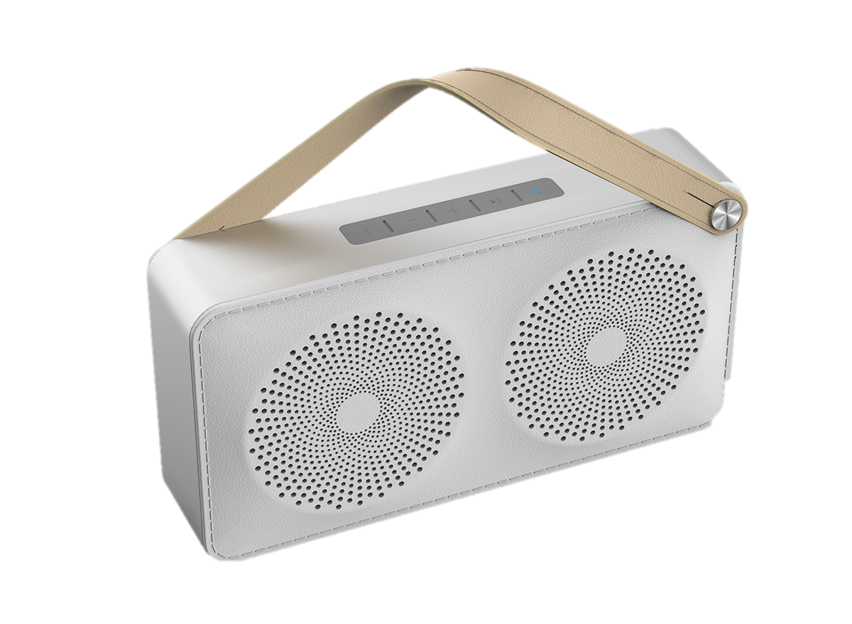
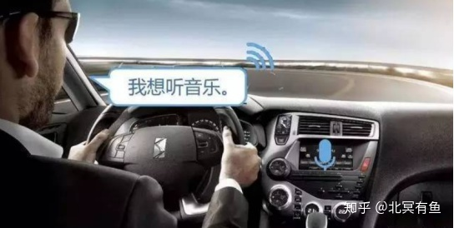
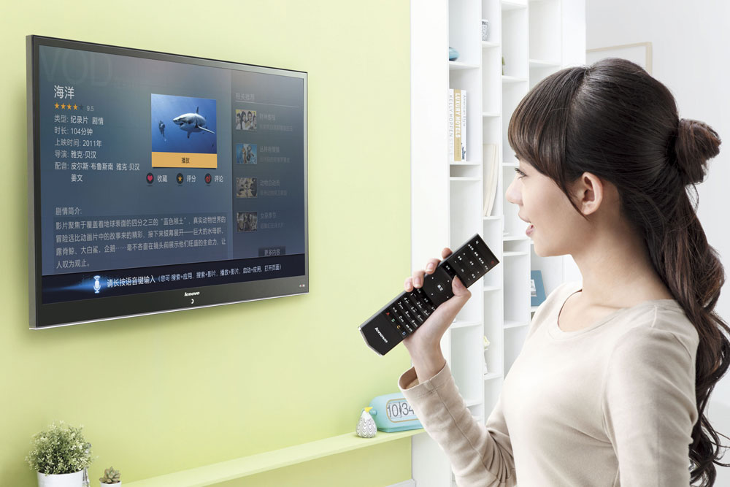
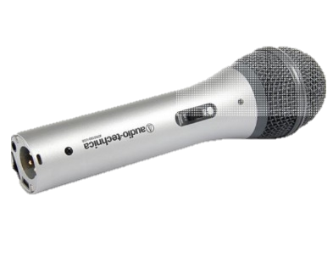
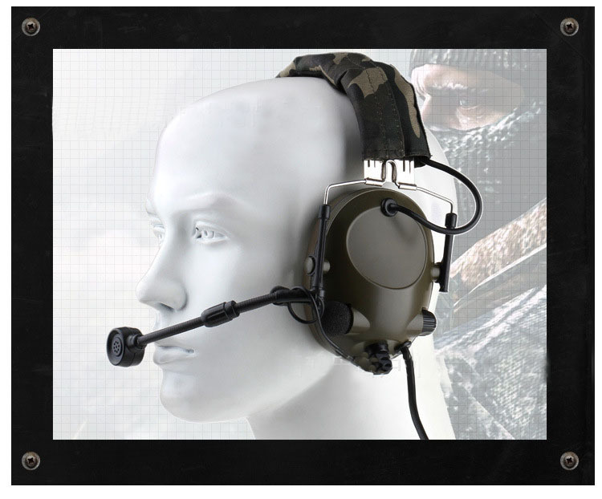
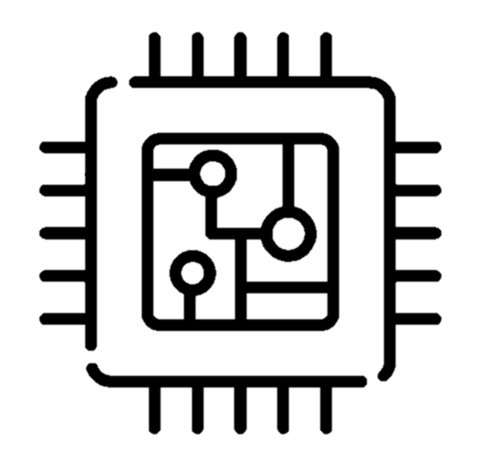
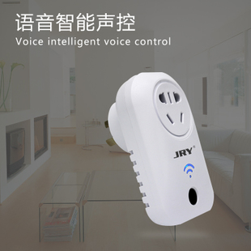
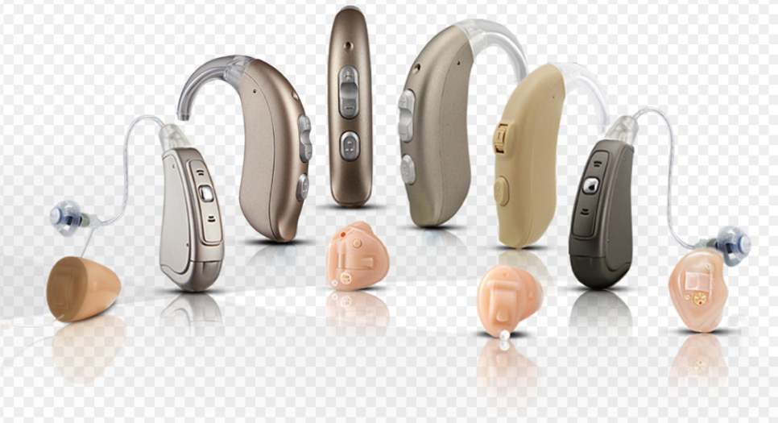
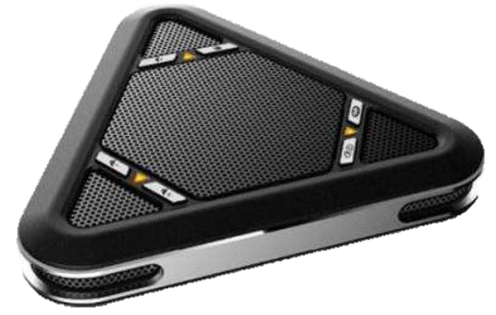
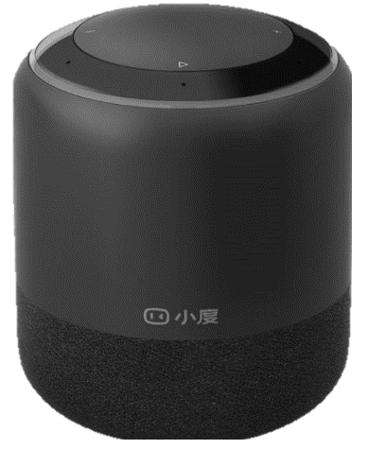
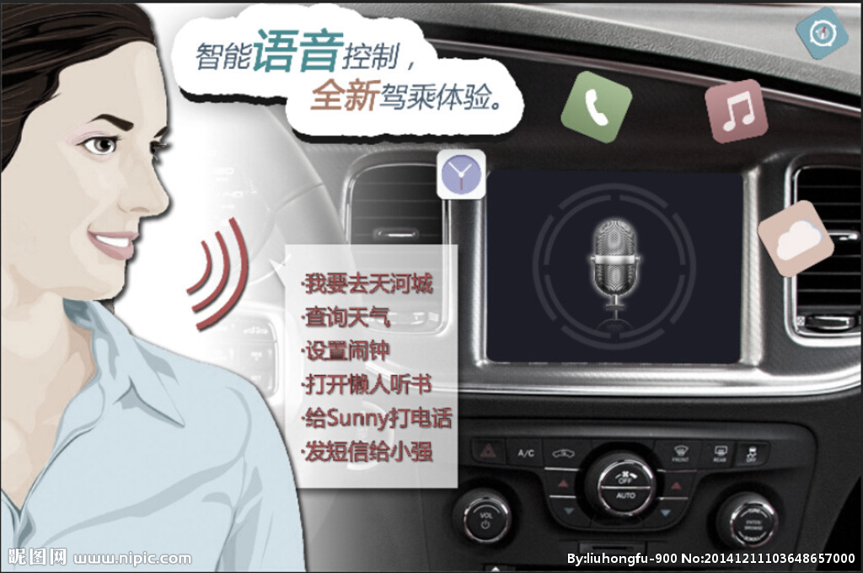





Deep into the professional audio market
音频处理芯片
AIoT
Headset
Microphone
Speakers
Auto
特种行业
2022年中国智能语音产业规模达215亿元且维持较高增速，预计到2026年产业规模可达469亿元
2021年全球耳机出货近10亿条，其中有线耳机超过6亿条；专业耳机（降噪、游戏、Hi-Res）3亿台以上
2021年中国视频会议行业市场规模达到148.2亿元，同比增长18.3% ，2023年有望突破200亿元。
预计2023年我国主要电子音响产品总市场规模将达4451亿元
2022年，汽车产销分别完成2702.1万辆和2686.4万辆。 2023年预计中国汽车市场总销量为2760万辆，同比增长3%
工业噪音隔离和听觉保护助听器和特种行业
Terminals with interaction and control requirements will have audio entry, increasing the requirements for sound quality and personalized perception
Soundec series chips deeply service for the professional pre/post-processing market
Notes:
AI-enhanced video, vision, audio, speech and security processing.

Slide 4
Contents
32Bit high performance audio signal processor
HiFi3 Architecture
Developer ecosystem
SDK Platform
Packaging & Electrical performance
Documents supporting

Slide 5

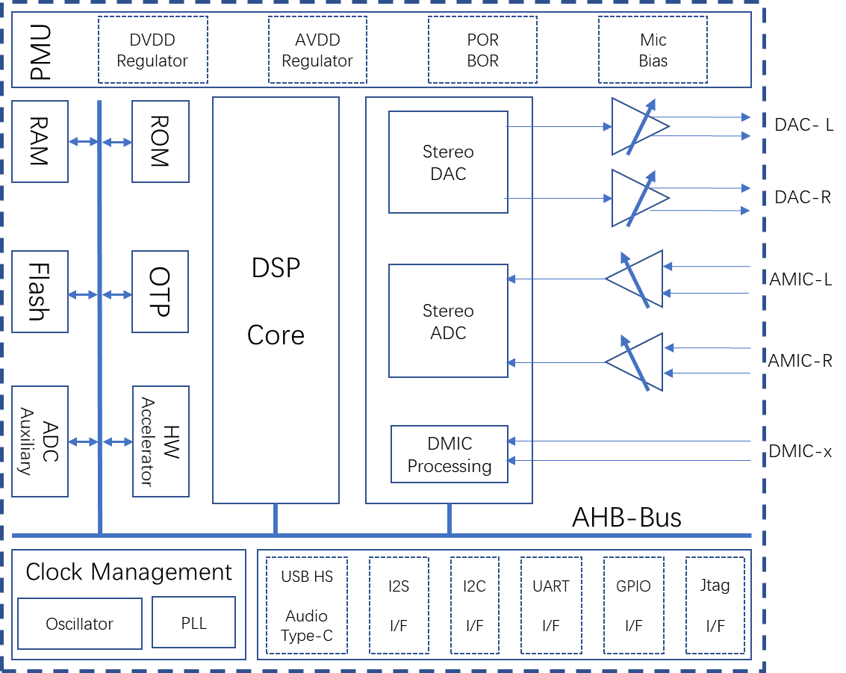
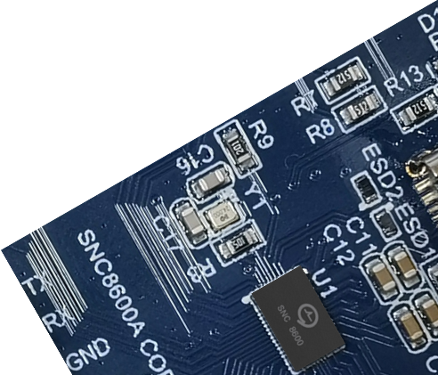
32Bit high performance audio signal processor
SNC8x series audio signal processor, integrated AI algorithm and high quality Codec, high performance DSP, USB2.0 HS device and power management unit.
High integration of SoC greatly reduces BOM cost and development cycle.
Rich developer ecosystem.
Key Features
Cadence Tensilica 32-bit HiFi3 DSP @200MHz
32-bit floating point unit, hardware acceleration
Build-in AGC、DRC、Mixer、Wind Noise filter
Build-in LDO and DC-DC power manager
24-bit high precision ADC, SNR>=106dB, sampling rate up to 192kHz
24-bit high precision DAC, SNR>=110dB, sampling rate up to 192kHz
USB2.0 HS/FS device, compliant with UAC Rev1.0 and Rev2.0
Three full duplex I²S input/output, sampling rate up to 192kHz
Up to 10 DMIC inputs/2 AMIC inputs
12-bit precision SAR ADC
Full duplex UART
Two I²C interface

Slide 6

HiFi3 Architecture
Tensilica HiFi DSP
Tensilica HiFi DSP series is the most licensed audio/sound/speech processor
With support for over 300 proven software packages.
More than 125 software partners in the Tensilica Xtensions™ partner program
More than 100 top-tier semiconductor companies and system OEMs have selected Tensilica HiFi DSPs for their audio, voice and speech products
HiFi3 Architecture
HiFi 3 is a VLIW architecture, supporting the execution of three operations in parallel.
Goes beyond the two MAC, four multipliers, three VLIW slots
Good support for 32x16-bit and 32x32-bit multiplication
A true 64-bit data path and native support for ITU-T/ETSI intrinsics.
An optional floating point unit available, providing for a 2-way SIMD, single-precision IEEE floating point MAC or ALU operation every cycle
HiFi3 DSP library
The HiFi3 DSP has an associated generic DSP library, which contains functions for FIR filters, IIR filters, basic math functions, matrix operations, and FFTs.

Slide 7
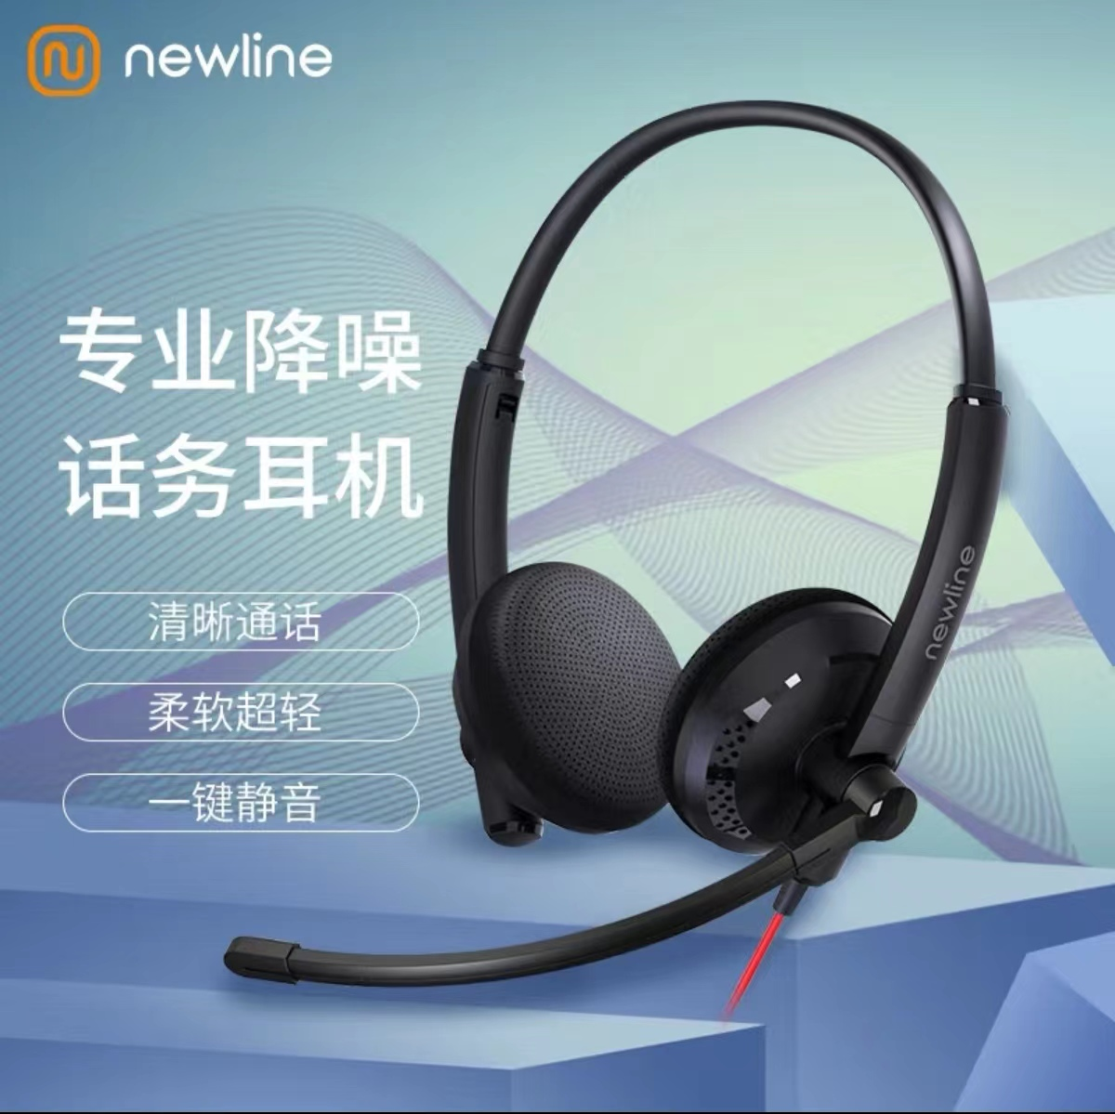
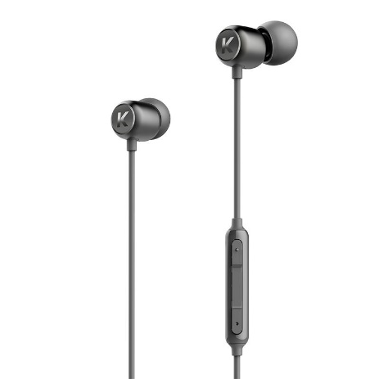
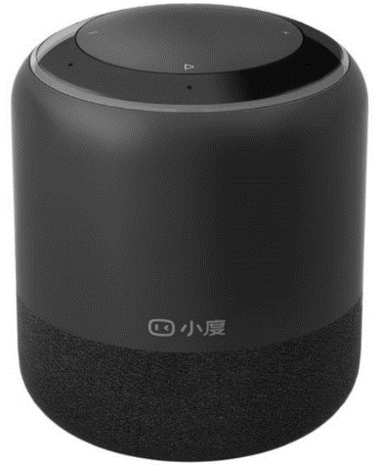
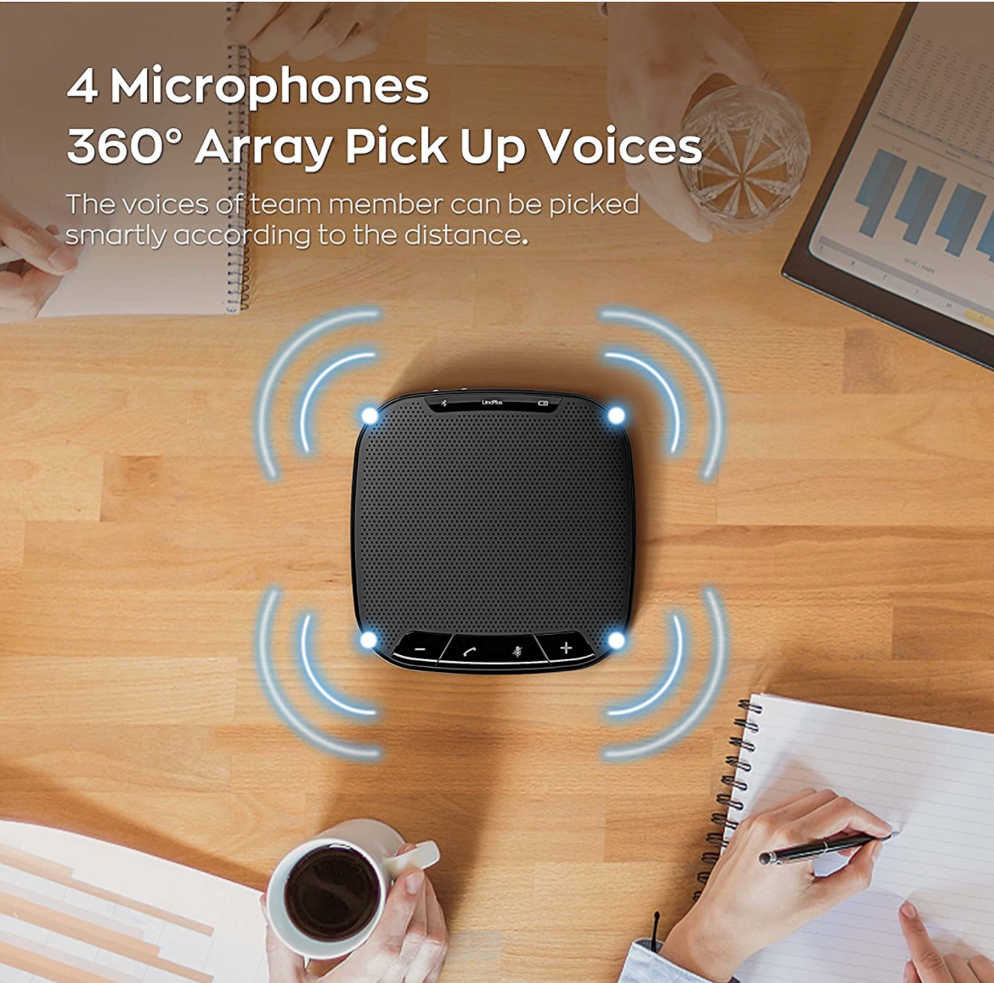
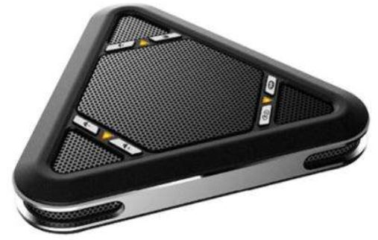
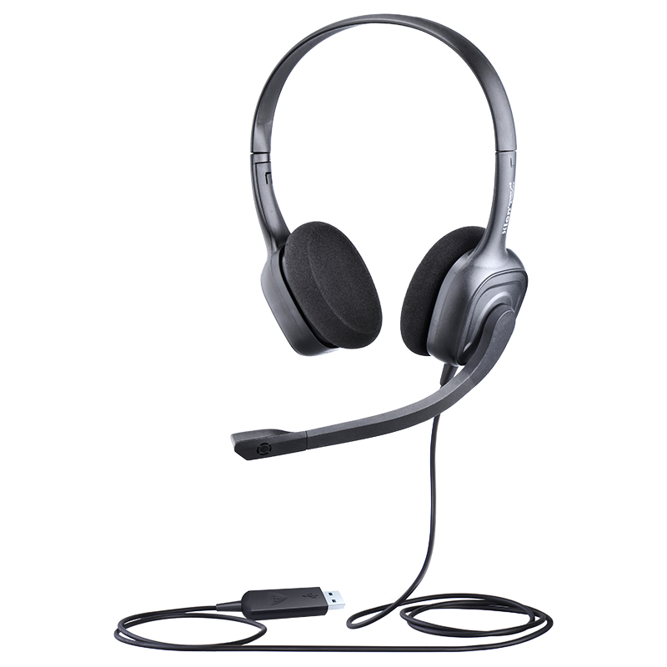
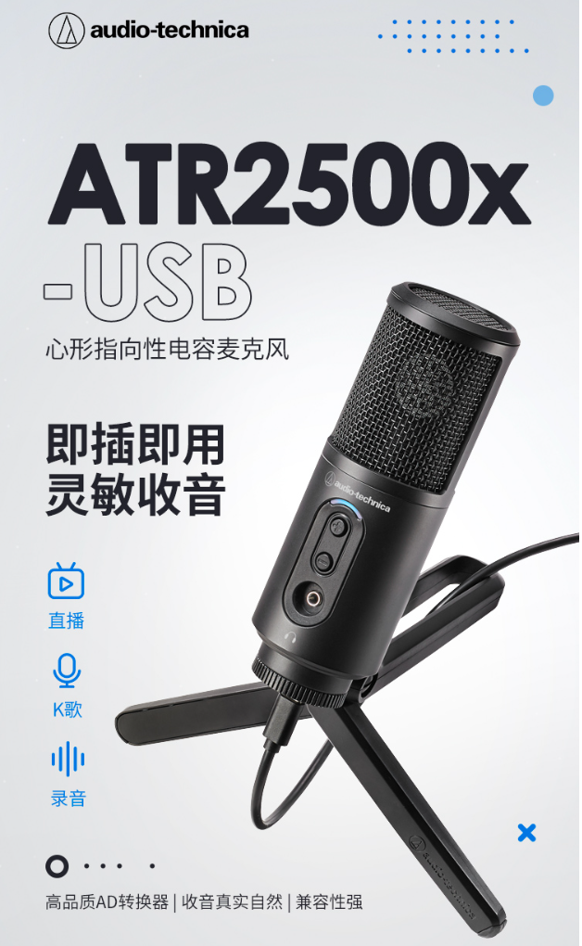
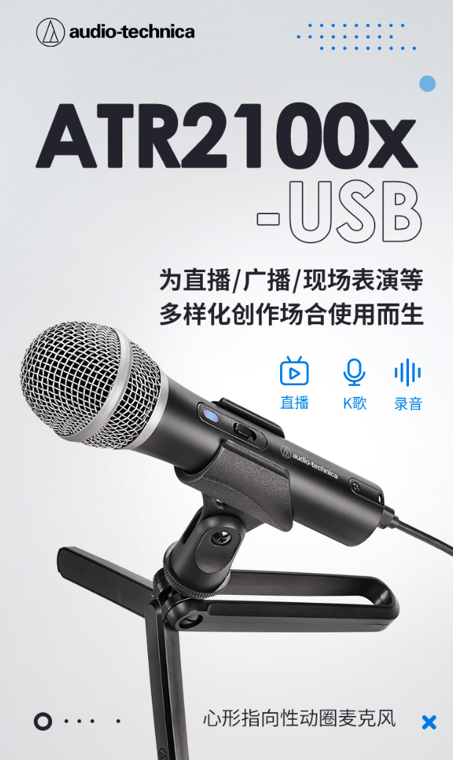
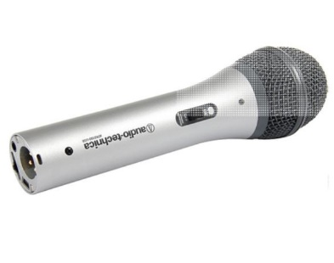
Developer ecosystem
Based on SNC8x SDK open platform, in-depth cooperation with more excellent partners
九音科技
Soundec
SDK Platform
Algorithm
算法公司
Partner
Partner
Brand
终端品牌
Partner
Trader
代理商
Partner
IDH
方案商

Slide 8









Developer ecosystem
Based on SNC8x SDK open platform, in-depth cooperation with more excellent partners
九音科技
Soundec
SDK Platform
Algorithm
算法公司
Partner
Partner
Brand
终端品牌
Partner
Trader
代理商
Partner
IDH
方案商
立讯精密

Slide 9
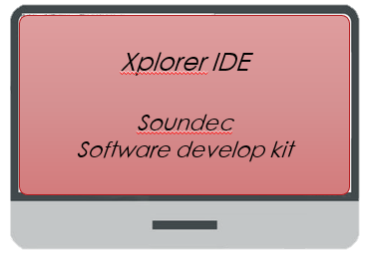
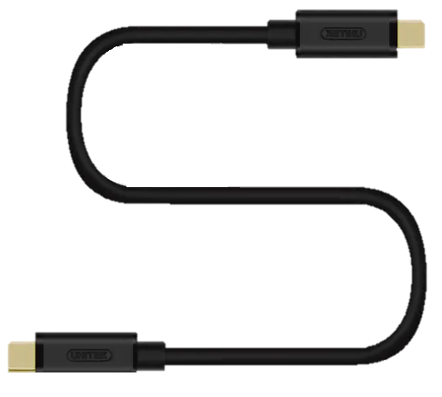
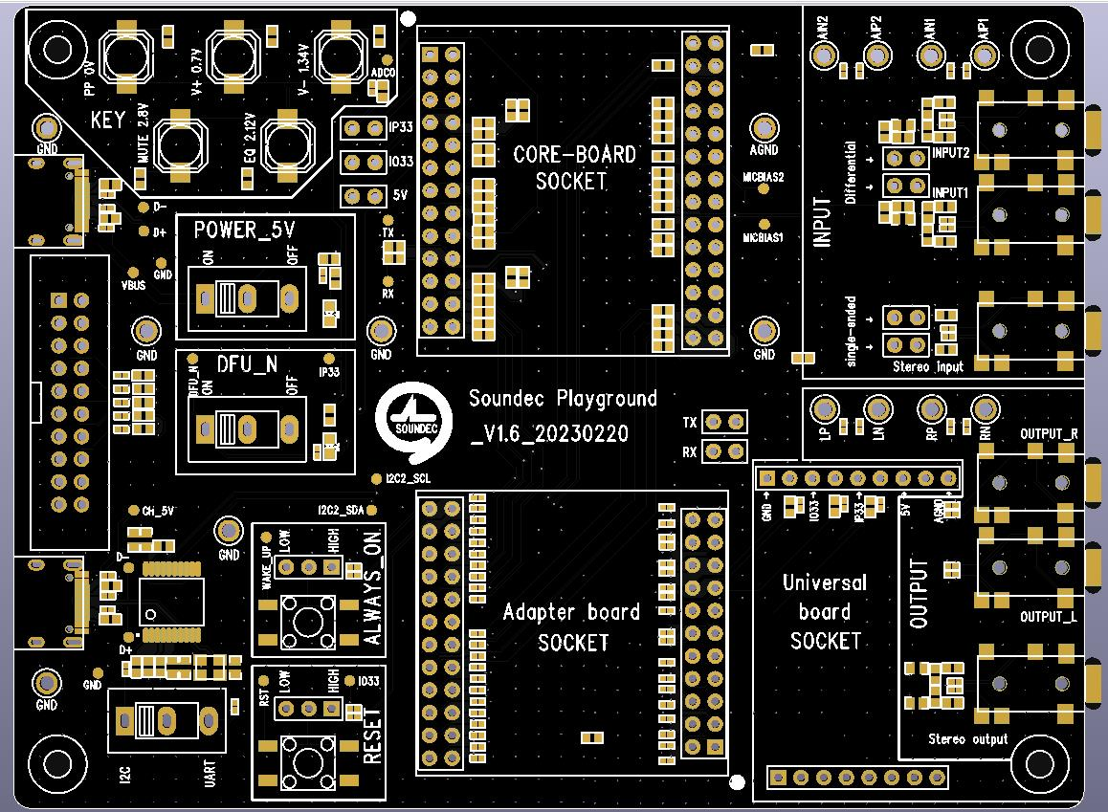

SDK开发平台
Software Develop Kit
USB Connection
EVA Board
Xtensa Xplorer
EVA board with full functions is provided for online debugging and sound settings
Support lotus head, 3.5mm, USB Type-C, USB Mini interface, developers can directly connect the instrument test
九音科技 Soundec
Software develop kit
(crypto for binary code)
Connect EVA board and PC via USB cable for debugging and code upgrade
测试主题： 系统效率 工作主频： 220MHz 测试SDK版本： SDK20_V1.0 |  |  |  |  | [注] USB模式下，采样精度为24Bit
采样率 | 音频通路（SDK可用dRAM空间>=217KB）
 | ADC->DAC | I2S->DAC | I2S->I2S | ADC->I2S | USB->DAC | ADC->USB
 | 可用算力资源 | 可用算力资源 | 可用算力资源 | 可用算力资源 | 可用算力资源 | 可用算力资源
48K@32bit | 94.79% | 94.75% | 94.1% | 94.3% | 95.17% | 94.36%
96K@32bit | 90.59% | 90.08% | 89.2% | 89.6% | 93,35% | 91.87%
192K@32bit | 82.52% | 81,38% | 79.25% | 80.21% | 89,59% | 85.97%

Slide 10
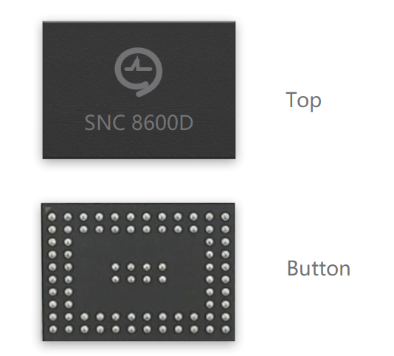
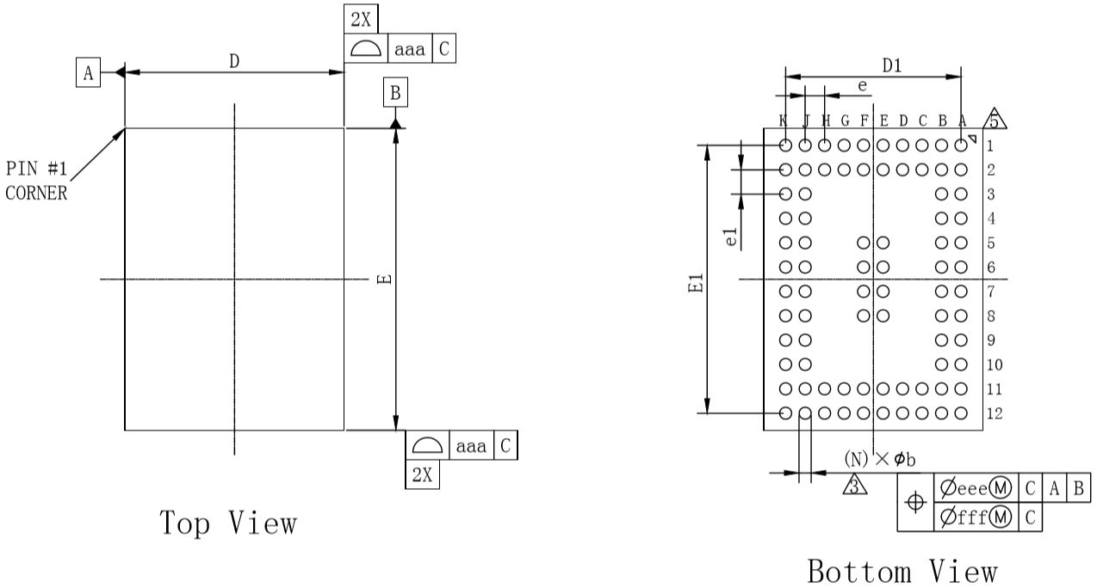
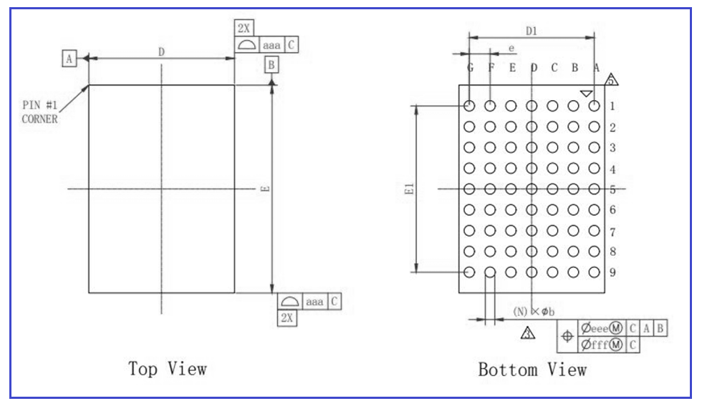
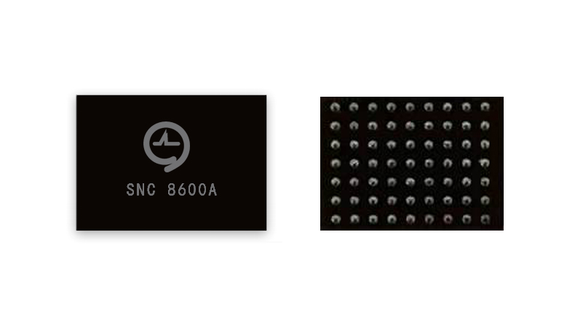
Packaging & Electrical performance
Packaging
Main electrical performance
SNC8600: BGA80
E: 6.2mm; D: 4.5mm; e: 0.4mm; e1: 0.5mm
Electrical performance
Power consumption(5V supply, 32Ω, 48KHz)
Powe consumption
I2S-DAC | <=12mA
USB-DAC | <=20mA
Latency
ADC-DAC | ＜3ms
ADC-USB | ＜10ms
ADC input Path(24bit,48KHz)
SNR | 106dB
Dynamic range | 106dB
THD+N | -88dB
DAC output Path (32Ω 24bit,48KHz GOM/GOD=0dB)
Output Power | 30mW
SNR | 101dB
Dynamic range | 110dB
THD+N | -81dB
Noise level | ＜5uVrms
SNC8600A: BGA63
E: 3.5mm; D: 4.5mm; e: 0.5mm; e1: 0.5mm
Notes:
P7 SNC 8600 芯片技术概要 （续）
- 功耗：不同应用下功耗差异
- 封装方式
- 其他重要信息
2023-2-10：
是否分应用列出功耗（参考ADI），硬件设计相关的主要参数：功耗、snr

Slide 11
Documents supporting
SNC8600 Datasheet
SNC8600 Reliability Testing Report
SNC8600A Datasheet
SNC8600A Reliability Testing Report
EVA Board application note
USB Compatibility report

Slide 12


Thank you
深圳市九音科技有限公司
Shenzhen Soundec Technology Co.,Ltd.
Contact us
Address： 深圳市南山区粤海街道高新科技园科技南十二路18号长虹科技大厦505室
Official website：https://www.soundec.cn/
Phone: +86 0755-86662489
E-Mail: info@soundec.com

